Slide 1
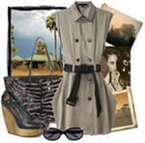
SHOPPING FOR CLOTHES

Slide 2
PHONETIC ACTIVITIES
[ou] – сlothes, (rain)coat
[au] – blouse, trousers,
[eɪ] – trainers,
[u:] – shoes, boots
[ju:] - suit
[a:] - scarf
[ᴐ:] - shorts
[ә:] – skirt, shirt

Slide 3
The clothes rhyme
Socks and shoes and jeans and shirt
Trousers, coat and blouse and skirt

Slide 4
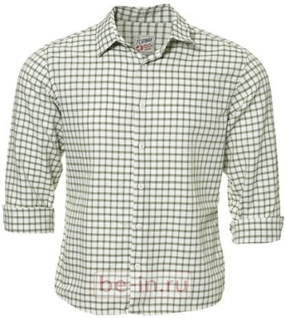
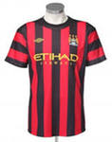
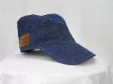
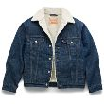
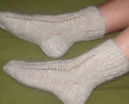
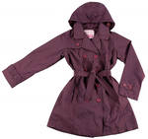
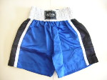
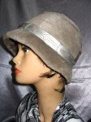
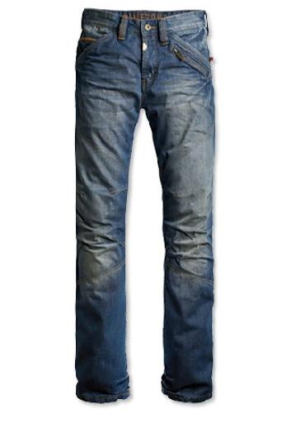
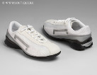
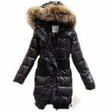
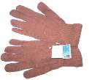
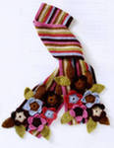
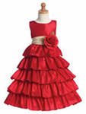
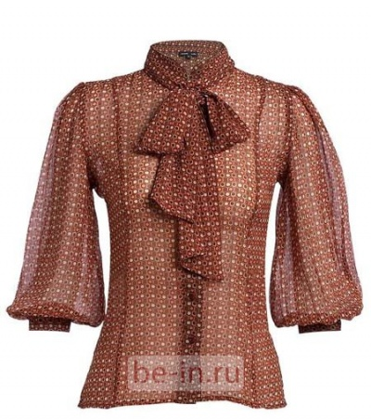
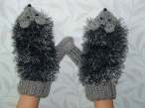
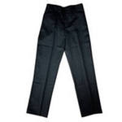

Slide 5
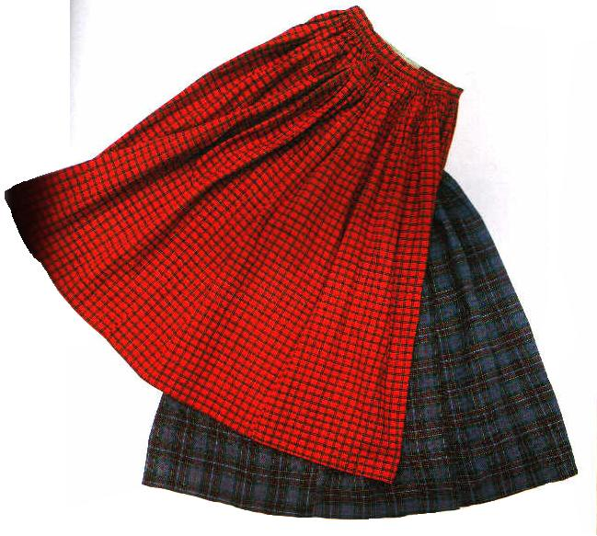
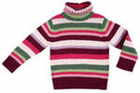
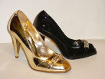

Slide 6
Complete the words
1) s c o t h e l
2) s e r d s
3) t a h
4) t i r s h
5) w e a r t e s
6) m i n t e t
7) k o c s
8) u t i s
9) s o e h s

Slide 7
Check out the words
1) clothes
2) dress
3) hat
4) shirt
5) sweater
6) mitten
7) sock
8) suit
9) shoes

Slide 8
My favourite clothes are …

Slide 9
Let us REMEMBER !
to wear – носить (одежду)

Slide 10
What do you wear on your head? I wear …

Slide 11
What do you wear on your feet? I wear …

Slide 12
What do you wear on your hands? I wear …

Slide 13
Let us check your homework.
What do you wear in winter when the weather is cold?
( I wear …..)
2. What do you wear in spring and in autumn when the weather is cool?
3. What do you wear in summer when the weather is hot and warm?

Slide 14
REMEMBER!
L
to have on – быть одетым в …

Slide 15
Find 3 differences
Helen has … on. But Betsy has … on.

Slide 16
Let us REMEMBER!
to put on – надевать

Slide 17
I am a clown !
I put on my socks,
I put on my shoes,
I put on my shirt,
And my trousers too.
I put on my jacket,
I put on my hat.
Look! I am a clown
I am very glad!

Slide 18
Welcome to the shop!

Slide 19
READ AND TRANSLATE
Can I help you?
Show me the …, please.
Here you are.
I like this (these) …
How much … …?
25 pounds. Anything else?
No, thank you.
That is all.

Slide 20
AT the shop
A: Can I … you?
C: Show me the …, please.
A: Here … … .
C: I like this (these) … . How much … …?
A: ( 25 ) pounds. Anything else?
C: No, ... you. That is … .
A: OK. Good … .
C: … .

Slide 21
HOMEWORK:
Make a crossword on the theme
“Clothes”,
Learn the dialogue by heart.

Slide 22
REFLECTION
Do you like our lesson?
What do you like?
What was interesting for you?
What was new for you?
What was easy for you?
What was hard for you?

Slide 23
Thank you for the lesson!
GOODBYE !

